Slide 1
SPECS: A Lightweight Runtime Mechanism for Protecting Software from Security-Critical Processor Bugs
Matthew Hicks, Michigan
Cynthia Sturton, UNC
Samuel T. King, Twitter
Jonathan M. Smith, UPenn
Notes:
Thank you for attending my talk.
Today I am going to talk about processor bugs.
Specifically, I am going to tell you about our analysis of and a novel system for detecting activations of a subset of processor bugs that weaken the security of the entire system.
This work is the product of an eclectic collaboration consisting of myself, Cynthia Sturton, Sam King, and Jonathan Smith.
0:22

Slide 2
Architectural success leads to increased complexity
Performance
Cost
Power
Reliability
Notes:
We, as architects, often focus on increasing performance and reducing power
But, another important part of our job is to address the inevitable imperfections that result from the added complexity from our drive for power and performance

Slide 3
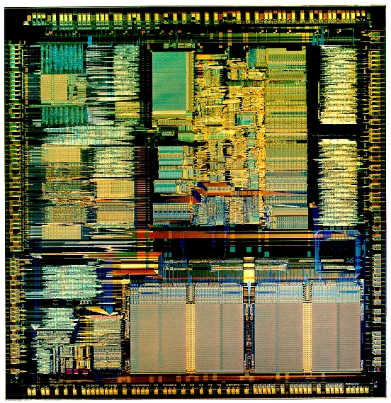
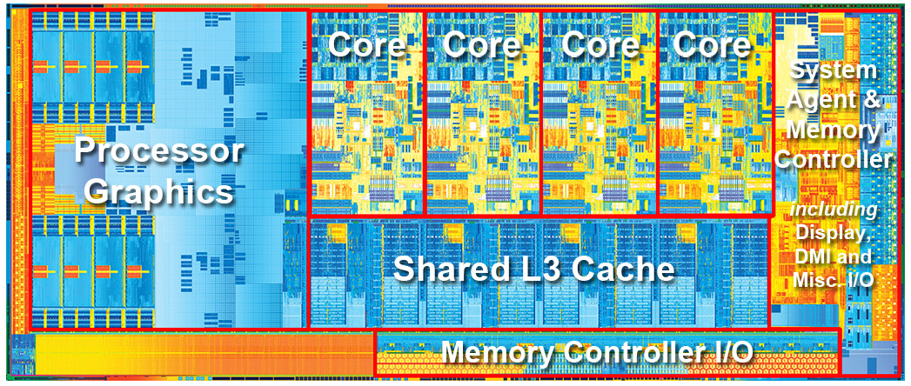
Architectural success leads to increased complexity
1985
.3M Transistors
2012
1,400M Transistors
Notes:
For example, between the 386 processor of 1985 and the Core-i7 processor with integrated graphics of 2012 there was a 5,000 times increase in transistors.
If you assume a rough equivalence between transistors and functionality, that is roughly 5,000 times more functionality packed into the i7 than in the 386.

Slide 4

Increased complexity leads to more bugs
4 years
136 errata
3 bugs/month
Notes:
Obviously, such dramatic increases in functionality come at a cost.
One cost is design bugs.
Much like in software, every new line of hardware description comes with the risk of making a mistake.
For example, the errata for this Core-i7 documents 136 bugs, and those are only the known bugs. For comparison, the 386 had 4.

Slide 5
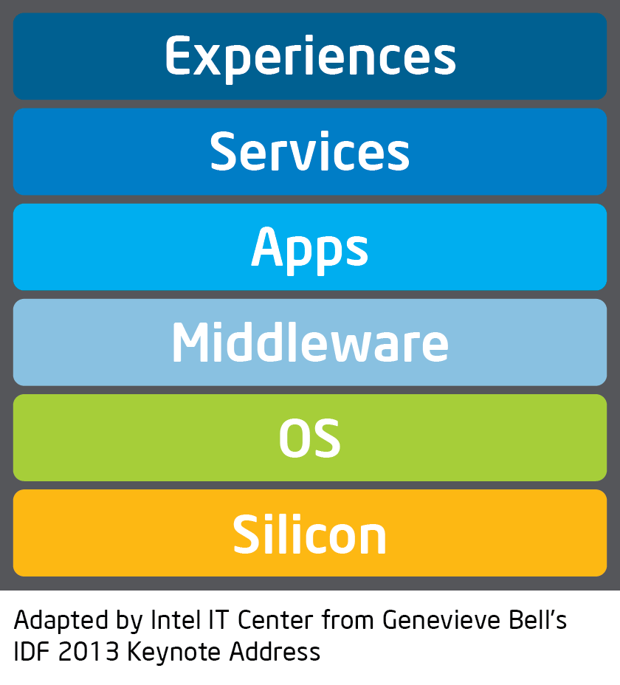
Processor bugs are permanent and powerful
Notes:
Processor bugs are important because they are permanent and powerful; they affect the entire system:
that is to say, a bug in hardware is also a bug in the software, even perfect software, that runs on that hardware.

Slide 6
Hardware-only approaches are expensive, while software-only approaches are limited
Processor Bugs
Notes:
Being an important problem, architects have addressed processor bugs with both hardware-only and software-only approaches

Slide 7
Hardware-only approaches are expensive, while software-only approaches are limited
HW Bug Patching
Checker Core
Notes:
Hardware-only approaches are powerful because they have access to the entirety of hardware state and can verify that state every clock cycle.
The drawback of hardware-only approaches is hardware overhead, with some approaches requiring the processor’s area to increase to 2 to 3 times its original size

Slide 8
Hardware-only approaches are expensive, while software-only approaches are limited
Software Bug Patching
Unpatched
Bugs
Notes:
On the other end of the spectrum are software-only approaches.
Software-only approaches are flexible and low cost due to their targeted nature.
The drawback of software-only approaches is that they have limited insight into hardware’s state.
Software must trust a subset of the processor because they cannot see all hardware state and rely on hardware-provided introspection points to verify computation.
If a bug contaminates critical processor state that is essential for security, for example the privilege level, without creating an introspection point,
then malicious software could prevent the checker software from running correctly.

Slide 9
SPECS is targeted hardware that provides ad hoc introspection points to recovery/repair software
Software Bug Patching
SPECS
Notes:
To fill in the gap left by software-only approaches, creating a hybrid approach, we provide SPECS.
SPECS is lightweight hardware that dynamically verifies the subset of processor functionality that software must trust.
In this way, SPECS creates new introspection points for software to check-up and correct on computation.

Slide 10
SPECS - Security-critical Processor Errata Catching System
ISA
state
Processor
Exception
Notes:
As an overview of SPECS, we start with a processor and the software stack that runs on that processor

Slide 11
SPECS - Security-critical Processor Errata Catching System
ISA
state
Processor
Exception
Notes:
At some point during the design stage a bug that corrupts security-critical (aka privileged) processor state is added.
In the first part of this talk, I will tell you about our analysis of 7 years of commercial processor errata aimed at understanding the prevalence and types of security-critical bugs

Slide 12
SPECS - Security-critical Processor Errata Catching System
Software
ISA
state
SPECS
Exception
Notes:
In the second part of this talk, I am going to talk about SPECS, our security-critical processor errata catching system.
As you can see in the figure, specs is lightweight hardware that silently and dynamically verifies updates to ISA-level state.

Slide 13
SPECS - Security-critical Processor Errata Catching System
Software
Recovery
Repair
ISA
state
SPECS
Exception
Notes:
If SPECS ever sees an ISA state update that is inconsistent with the specification (a rare event that probably indicates an attack), it squashes the corrupted in-flight state and invokes existing software-implemented recovery and repair systems to move execution forward, past the bug.
In the final part of this talk I will tell you about how SPECS fares against software attacks that leverage security-critical errata.

Slide 14
Analyze commercial processor errata to quantify the magnitude of the problem
Athlon
Athlon X2
Athlon Neo
Athlon Neo X2
Athlon 64
Athlon 64 FX
Athlon 64 X2
Opteron
Opteron Dual-Core
Sempron
Sempron Dual-Core
Turion 64
Turion 64 X2
Turion Neo X2
Phenom II X3
Phenom II X4
Phenom II X6
Phenom II XLT
Phenom II Dual-Core
Phenom II Triple-Core
Phenom II Quad-Core
Sempron X2
Sempron Mobile
Turion II Dual-Core Mobile
Turion II Ultra Dual-Core Mobile
Turion II Neo Dual-Core Mobile
V-Series
V-Series Dual-Core
Athlon X2 Dual-Core
Sempron X2 Dual-Core
Turion X2 Dual-Core Mobile
Turion X2 Ultra Dual-Core Mobile
A-Series Mobile APU
E2-Series Mobile APU
A-Series APU
E2-Series APU
Athlon II X2 Dual-Core
Athlon II X4 Quad-Core
C-Series
C-Series Dual-Core
E-Series Dual-Core
E-Series
E-Series Dual-Core
G-Series
G-Series Dual-Core
Z-Series Dual-Core
FX-Series
Opteron 3200 Series
Opteron 3300 Series
Opteron 4200 Series
Opteron 4300 Series
Opteron 6200 Series
Opteron 6300 Series
R-Series APU
R-Series
FirePro APU
Athlon Dual-Core
Athlon Quad-Core
E-Series Mobile APU
G-Series Mobile APU
G-Series SoC
Opteron X1100 Series
Opteron X2100 Series APU
Notes:
Before I tell you more about the design and implementation of SPECS, it is important that I provide a deeper understanding of security-critical errata.
To understand the magnitude of the problem, we looked at real-world bugs in a recent 7-year span of commercial processors.
In the seven year’s of errata, we analyzed errata from over 60 processors; shown here.

Slide 15


Security-critical errata impact privileged state or events
General Bug
Security-Critical Bug
Notes:
When analyzing each erratum, we ask ourselves whether the effect of the bug impacts privileged state (for example privilege, page tables, or hardware virtualization registers) or special events (for example, taking an exception).
We call errata that fit this definition security-critical errata.
From a high-level, we think of these errata as potential footholds for attacks emanating from underprivileged software.

Slide 16
Security-critical errata exist in all inspected processors
Notes:
After analyzing 300 unique errata, we found that 28 of the errata fit our definition of security-critical errata.
That is over 9%.
Even more importantly, every single processor is affected by at least one SCE and that most SCE had no fix listed.

Slide 17
Security-critical errata come from five effects-based classes
Notes:
Digging a little deeper, what do SCE have in common?
Through effects-based analysis of the 28 SCE, we found that they could be classified into one of five classes.
Note that we focus on the effect of the bug, not how that effect is achieved.
Explain each class and have an example.

Slide 18
SPECS protects security-critical processor state
Software
9% errata are security-critical
All processors afflicted
Come from 1 of 5 effects-based classes
ISA
state
Processor
Exception
Notes:
Recap what we just learned
Bridge to defense
Driving observation

Slide 19
SPECS protects security-critical processor state
Software
9% errata are security-critical
All processors afflicted
Come from 1 of 5 effects-based classes
Observation
Security-critical processor state is updated in a few, simple ways
ISA
state
Processor
Exception
Notes:
Recap what we just learned
Bridge to defense
Driving observation

Slide 20
SPECS protects security-critical processor state
Software
9% errata are security-critical
All processors afflicted
Come from 1 of 5 effects-based classes
Observation
Security-critical processor state is updated in a few, simple ways
Implication
Security-critical state checkers are simple
ISA
state
Invariants
Exception
Notes:
Recap what we just learned
Bridge to defense
Driving observation

Slide 21
SPECS dynamically verifies ISA state updates
Software
Recovery
Repair
Observations
Security-critical processor state is updated in a few, simple ways
ISA-level state provides enough information for accurate detection
Implications
Security-critical state checkers are simple
ISA
state
Invariants
Exception

Slide 22
SPECS dynamically verifies ISA state updates
Software
Recovery
Repair
Observations
Security-critical processor state is updated in a few, simple ways
ISA-level state provides enough information for accurate detection
Implications
Security-critical state checkers are simple
Security-critical state checkers are understandable and portable
ISA
state
Invariants
Exception

Slide 23
SPECS invariants are a composition of simple assertions on ISA-level state
Software
Recovery
Repair
ISA-level state
always
on edge
next
delta
& | ~ == !=
ISA
state
Invariants
Exception

Slide 24
Example SPECS invariant
No privilege escalation
If the processor goes from user to supervisor mode, then it must be due to a reset or exception/interrupt
// on reset?
on_edge(PRIV == SUPER, RST == 1) &
// on exception/interrupt?
(on_edge(PRIV == SUPER, PC & 0xFF == 0) | on_edge(PRIV == SUPER, PC & 0xFFFFF000 == 0))
Notes:
Invariants
Simple example

Slide 25
SPECS Invariants
Execution privilege matches page privilege
SPR = GPR in register move instructions
Updates to exception registers make sense
Destination matches the target
Memory value in = register value out
Register value in = memory value out
Memory address = effective address
Privilege escalates correctly
Privilege de-escalates correctly
Jumps update the PC correctly
Jumps update the LR correctly
Instruction is in a valid format
Continuous control flow
Exception return updates state correctly
Register change implies that it is the instruction target
SR is not written to a GPR in user mode
Interrupt/exception implies handled
Instruction not changed in the pipeline
Notes:
Come directly from use reading the processor specification.

Slide 26
SPECS Invariants
Execution privilege matches page privilege
SPR = GPR in register move instructions
Updates to exception registers make sense
Destination matches the target
Memory value in = register value out
Register value in = memory value out
Memory address = effective address
Privilege escalates correctly
Privilege de-escalates correctly
Jumps update the PC correctly
Jumps update the LR correctly
Instruction is in a valid format
Continuous control flow
Exception return updates state correctly
Register change implies that it is the instruction target
SR is not written to a GPR in user mode
Interrupt/exception implies handled
Instruction not changed in the pipeline
Notes:
Come from our analysis of the 28 SCE from AMD processors.

Slide 27
SPECS Invariants
Execution privilege matches page privilege
SPR = GPR in register move instructions
Updates to exception registers make sense
Destination matches the target
Memory value in = register value out
Register value in = memory value out
Memory address = effective address
Privilege escalates correctly
Privilege de-escalates correctly
Jumps update the PC correctly
Jumps update the LR correctly
Instruction is in a valid format
Continuous control flow
Exception return updates state correctly
Register change implies that it is the instruction target
SR is not written to a GPR in user mode
Interrupt/exception implies handled
Instruction not changed in the pipeline
Notes:
Based on what we missed in the first evaluation attempt

Slide 28
SPECS: dynamic invariant monitoring to create new introspection points
Software
Recovery
Repair
ISA
state
Assertions
Exception

Slide 29
SPECS: dynamic invariant monitoring to create new introspection points
Software
Recovery
Repair
ISA
state
Assertions
Exception

Slide 30
SPECS: dynamic invariant monitoring to create new introspection points
Software
Recovery
Repair
ISA
state
Assertions
Exception

Slide 31
SPECS: dynamic invariant monitoring to create new introspection points
Software
Recovery
Repair
ISA
state
Assertions
Exception

Slide 32
SPECS: dynamic invariant monitoring to create new introspection points
Software
Recovery
Repair
ISA
state
Assertions
Exception

Slide 33
Design Challenges
How to prevent bugs from altering ISA-level state in the event of a detection
How to ensure that SPECS has a consistent view of ISA-level state
What is the tradeoff between using only ISA-level state and detection precision

Slide 34
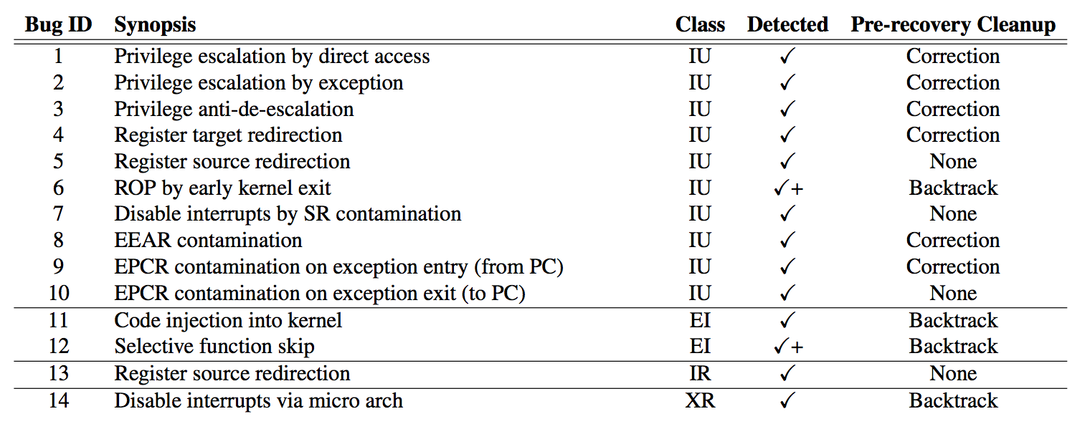
We evaluate SPECS using errata-based attacks
Notes:
So far we mined the SCE from over 60 processors, discovering that they taint all of the examined processors and that SCE have one of five effects.
Then I told you about SPECS, or effects based dynamic verification scheme targeted at verifying updates to SC processor states and events.
As a part of that, I showed you 18 invariants that we implement as a part of SPECS
Now we need know if SPECS works.
To this end, we implement 14 SCE-based attacks show here, with at least one attack for each class of SCE discussed earlier.

Slide 35
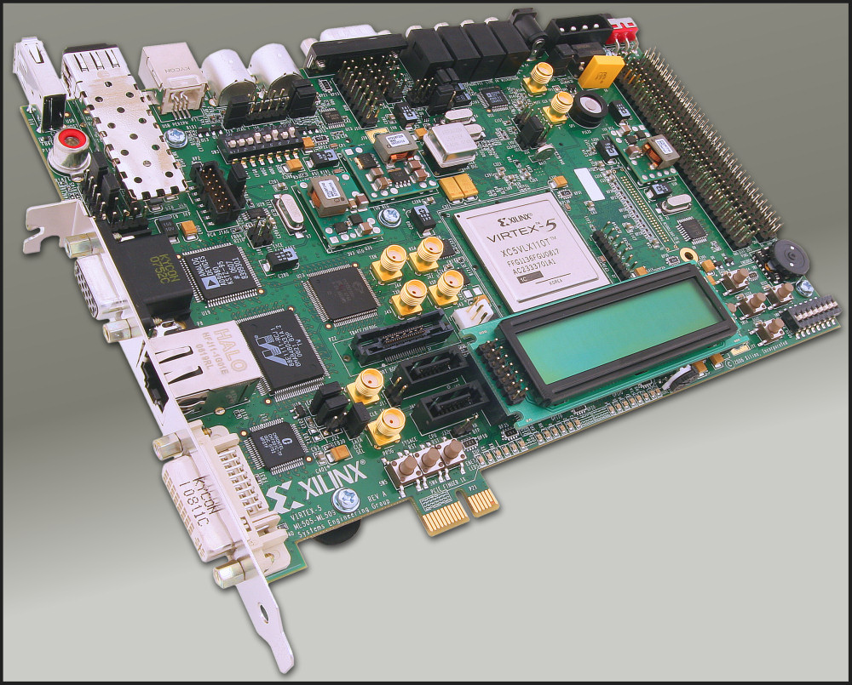

OpenRISC OR1200
Notes:
What we built.
Emphasize that we have linux user level softawre that exploits our added SC processor bugs as part of a software-level attack.

Slide 36
SPECS is effective

Slide 37
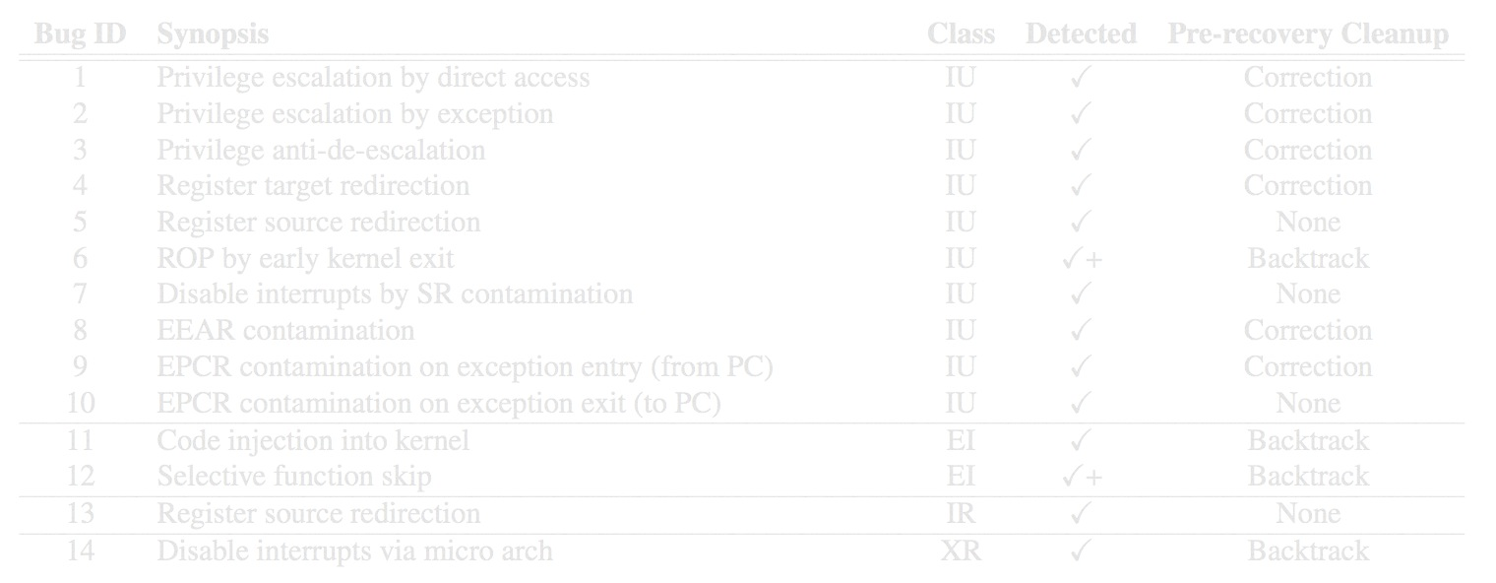
SPECS is effective
Notes:
Required micro-arch state (as opposed to only ISA-level state)

Slide 38
SPECS aids recovery/repair software
Notes:
We in the rightmost column, we list the state that SPECS leaves the system in post-detection for each of our attacks.
The goal here is to understand what extra work existing recovery and repair software is going to have to do to make forward progress after triggering a SCE.
Let me explain the three possible post-detection states are…

Slide 39
SPECS aids recovery/repair software
Notes:
Just take the exception and return from it is enough.
Very light weight.

Slide 40
SPECS aids recovery/repair software
Notes:
Most times, simply creating and returning from the exception is not enough to avoid re-activating the SCE.
For correction, privileged software must reset corrupted bits of processor state to a known good value.
Going back to privilege escalation, that would mean setting the privilege to user mode.
Many of these cases are due to the OR1200 pre-committing in-flight state.

Slide 41
SPECS aids recovery/repair software
Notes:
The most expensive cleanup requirement is backtrack.
Backtrack is required when processor state is overwritten and there is no default value to go back to.
This tends to happen when the processor executes incorrect instructions.

Slide 42
SPECS is efficient
Notes:
All 18 invariants vs only the invariants needed to detect the attacks

Slide 43
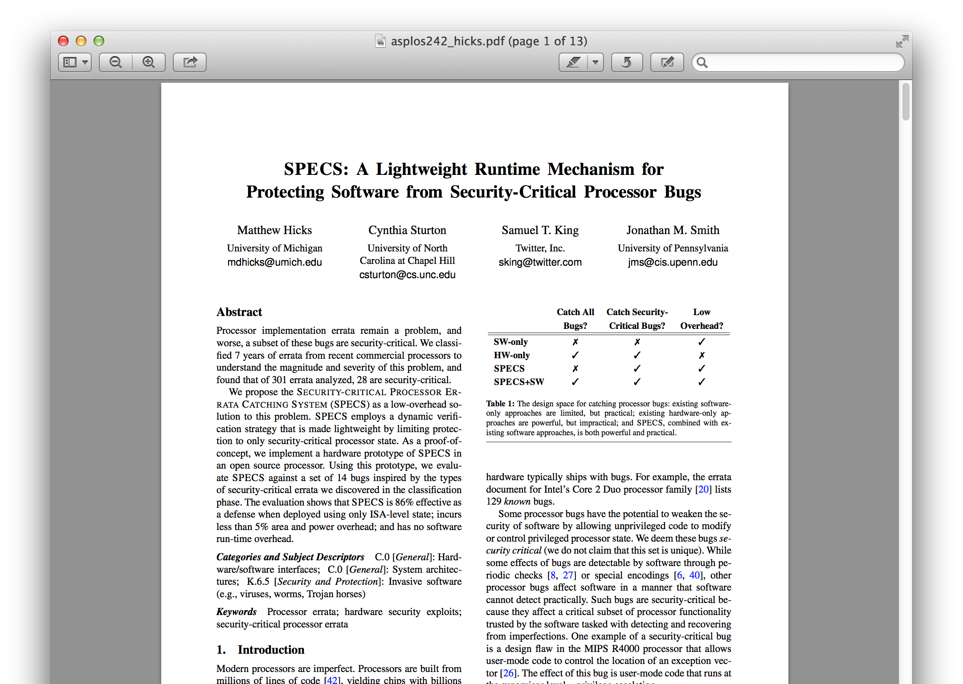
more in the paper…
Notes:
Say high-level goals of this pres and its eval
If you are interested in … you can find a deeper eval in the paper

Slide 44
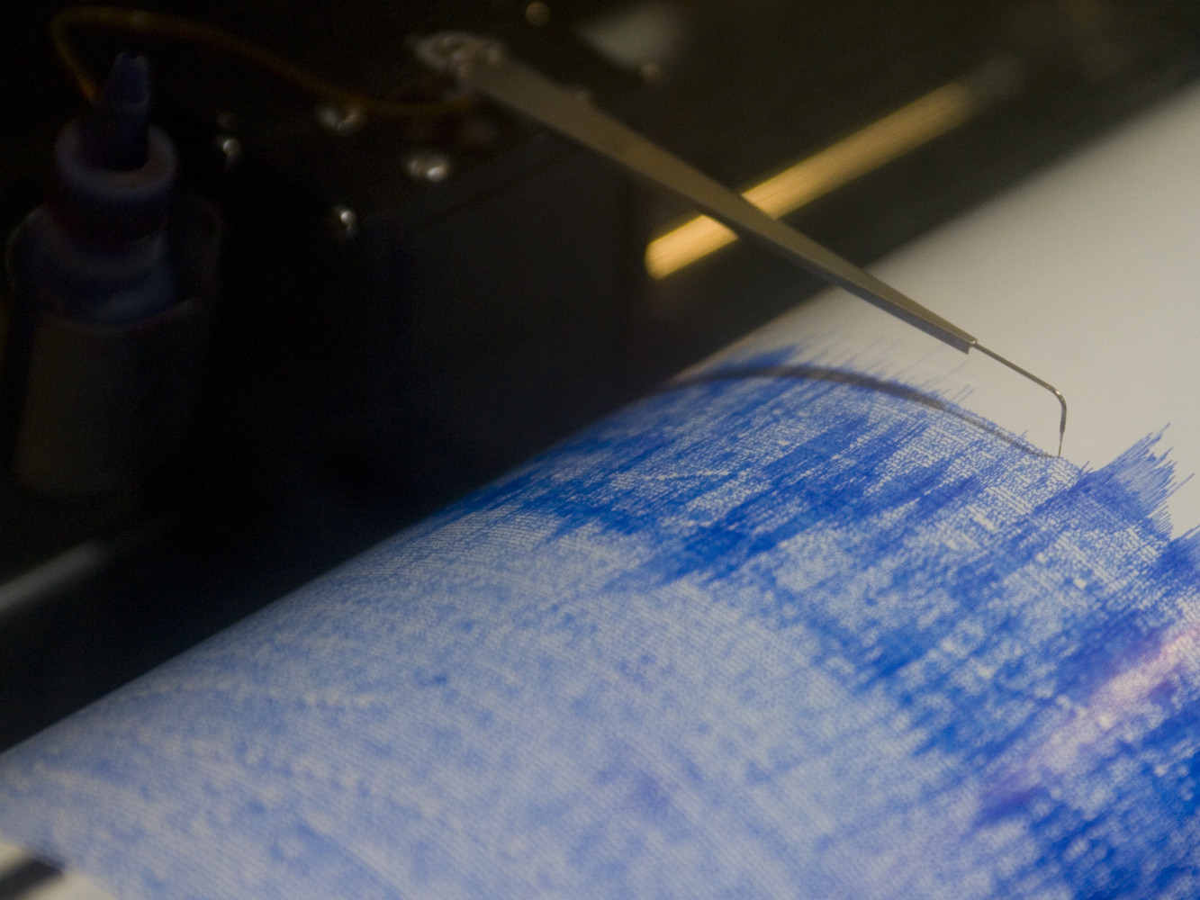
Targeted hardware detectors plus software is an effective and efficient approach for handling processor bugs
Notes:
We showed that security-critical errata exist and threaten system security.
We describe SPECS, a dynamic verification scheme that monitors invariants on isa-level state.
Finally, we showed that SPECS is effective and lightweight.
We feel that these results encourage our hybrid approach to patching processor bugs, but something is missing.
We still need a way to encode invariants dynamically to handle deployed bugs that bypass SPECS invariants built into the processor.

Slide 45
…but we still need reprogrammability to handle gaps in coverage
https://github.com/impedimentToProgress/specs
Notes:
We showed that security-critical errata exist and threaten system security.
We describe SPECS, a dynamic verification scheme that monitors invariants on isa-level state.
Finally, we showed that SPECS is effective and lightweight.
We feel that these results encourage our hybrid approach to patching processor bugs, but something is missing.
We still need a way to encode invariants dynamically to handle deployed bugs that bypass SPECS invariants built into the processor.

